Slide 1
THEIA
Phase I scenarios
Ubuntu Bros
CPT_S 484
Scenario slides and analysis: Jaydon Devictoria
Mock-up and manual: David Acosta Leon
Notes:
We are Ubuntu Bros, and this is THEIA. Jaydon prepared the scenarios and priority analysis. I made the mock-up and manual. We will go through the four examples, then show the mock-up.

Slide 2
Classroom trip: AS-IS
User: Stevie, a visually impaired student
Goal: Reach his next classroom
Feature: Spoken route guidance
Stevie is trying to go to his next classroom. He knows he needs to walk ahead a few steps, and then turn left around the corner.
However, he is not sure when to turn.
He took a guess, but turned too early, hit the wall and hurt his head.
Notes:
Stevie knows the general route, but he does not know when to turn. That is the main problem in this example. Source: supplied Theia-AS-IS_and_TO-BE_v2.0 classroom example.

Slide 3
Classroom trip: TO-BE
User: Stevie, a visually impaired student
Goal: Reach his next classroom
Feature: Spoken route guidance
1. Stevie opens THEIA. It asks for his current location and destination. He says his starting point and classroom.
2. THEIA reads both back. Stevie confirms them or corrects a mistake before starting.
3. THEIA calculates the route. Stevie confirms that he is ready to begin.
4. THEIA says, "walk ahead 10 steps, then turn left". Stevie follows the instruction.
5. Stevie can say "repeat" to hear the current instruction or "stop" to end guidance.
6. THEIA gives the next instruction as he follows the route and announces arrival at the classroom.
Expected result: Stevie reaches the intended classroom with guidance at each route decision.
Notes:
First, Stevie confirms where he starts and which classroom he needs. Then he can begin. The ten steps and left turn come from the course example. They are not measured by this mock-up. Repeat plays the same instruction, and stop ends guidance. Source: course scenario template and Jaydon handoff.

Slide 4
Blocked hallway: AS-IS
User: A visually impaired student on a familiar route
Goal: Get past a blocked hallway and reach class
Feature: Obstacle warning and route changes
The student walks toward a classroom using a hallway they already know.
A maintenance cart now blocks the hallway. Their remembered directions do not account for it.
The student stops and asks someone whether there is another way around.
Result: The trip is interrupted, and the student needs new information before continuing.
Notes:
Here, a cart blocks a route the student already knows. Remembering the building does not tell them that something has changed.

Slide 5
Blocked hallway: TO-BE
User: A visually impaired student on a familiar route
Goal: Get past a blocked hallway and reach class
Feature: Obstacle warning and route changes
1. During guidance, THEIA receives information that the hallway ahead is blocked.
2. THEIA says, "The hallway ahead is blocked. Stop here." The student stops.
3. If a usable alternative is known, THEIA explains the route change and asks whether to use it.
4. The student says "use that route". THEIA replaces the old directions and reads the first updated instruction.
5. The student follows the new route, using "repeat" or "stop" if needed.
Expected result: The student avoids the blocked section and receives directions toward the same classroom.
Notes:
THEIA warns the student and pauses guidance. It explains another route and waits for the student to accept it. We assume blockage information is available. This mock-up does not detect a real cart.

Slide 6
Blocked hallway: Possible problems
User: The student from the blocked hallway scenario
No alternative is known: THEIA says it cannot provide a route around the blockage. The student can request help or stop guidance.
The student declines the change: THEIA keeps guidance paused and asks whether they want help or to stop.
The warning was missed: The student can say "repeat" to hear the warning again before choosing what to do.
Assumption for this example: The blockage is known before the student reaches it. The mock-up supplies that information.
Notes:
If there is no usable route, or the student declines it, guidance stays paused. The student can ask for help or stop.

Slide 7
Lost visitor: AS-IS
User: A visually impaired visitor in an unfamiliar building
Goal: Reach someone who can help them get oriented
Feature: Requesting help when location is unclear
The visitor loses track of their location while trying to find a room.
They stop, but cannot confidently describe the hallway they are in.
They try to find someone nearby who can help them get oriented.
Result: The visitor cannot continue the trip confidently and has no clear confirmation that help is coming.
Notes:
The visitor is lost and cannot give a reliable current location. Requesting help does not solve that location problem by itself.

Slide 8
Lost visitor: TO-BE
User: A visually impaired visitor in an unfamiliar building
Goal: Reach someone who can help them get oriented
Feature: Requesting help when location is unclear
1. THEIA says the current location is uncertain and pauses route guidance.
2. The visitor says "help". THEIA reads the available support contacts.
3. The visitor says a contact's name. THEIA reads the choice back and asks whether to request help.
4. The visitor says "confirm". THEIA starts the request and says whether it is connecting or has connected.
5. If the contact responds, the visitor speaks with them and explains any landmarks they can identify.
Expected result: The visitor reaches a chosen support contact and understands whether the request connected.
Notes:
The visitor checks the contact and confirms the request. Waiting for an answer and being connected are different results. Our mock-up shows those results as text. It does not call anyone.

Slide 9
Lost visitor: Possible problems
User: The visitor from the help request scenario
The wrong contact was selected: The visitor corrects the choice before confirming the request.
The visitor cancels before confirming: THEIA does not contact anyone and keeps route guidance paused.
The contact cannot be reached: THEIA says the request did not connect and offers another contact or cancellation.
Location is still uncertain: THEIA says so. A request does not mean someone has responded or knows where the visitor is.
Notes:
Before confirmation, cancel means no request is sent. Once the request has started, cancel cannot undo contact that already happened. Guidance stays paused while the location is uncertain.

Slide 10
Guidance settings: AS-IS
Users: A visually impaired user and their caretaker
Goal: Make spoken guidance easier to hear and follow
Feature: Spoken guidance settings
The user finds the spoken directions too quiet and hears repeated instructions more often than they need.
They ask their caretaker to help adjust the settings.
The user has trouble checking visual controls and cannot easily tell whether the changes are right.
Result: The caretaker can help make changes, but the user cannot easily check or approve the result.
Notes:
The caretaker can help with settings, but the user still needs to check and approve the change.

Slide 11
Guidance settings: TO-BE
Users: A visually impaired user and their caretaker
Goal: Make spoken guidance easier to hear and follow
Feature: Spoken guidance settings
1. The user says "settings". THEIA reads the current volume and instruction frequency.
2. THEIA reads the choices. The user says "louder" and "fewer repeats" to select the changes.
3. THEIA reads back the proposed changes and plays a sample instruction.
4. The user listens, then changes the choices again or says "save" to confirm them.
5. THEIA says the settings were saved. Saying "cancel" before saving keeps the previous settings.
Expected result: The user can hear and approve the guidance settings, with caretaker help if needed.
Notes:
The user checks the current settings, chooses louder prompts and fewer repeats, then previews the change. Save applies it. Cancel before saving keeps the old settings. The mock-up shows the prompts as text.

Slide 12
Guidance settings: Possible problems
Users: The user and caretaker from the settings scenario
The choice is not understood: THEIA asks the user to repeat it and keeps the previous settings.
The sample is still too quiet: The user chooses a louder setting and previews it again before saving.
The user cancels: THEIA discards the proposed changes and confirms that the previous settings remain.
Fewer repeats must still include necessary turn instructions and hazard warnings. The setting changes repetition, not essential guidance.
Notes:
Fewer repeats means fewer repeated prompts. It does not remove turns or warnings. The caretaker helps, and the user approves.

Slide 13
Top priority: Classroom guidance
Priority: A repeated student trip with a risk of injury
Lesson 6 analysis of the classroom TO-BE scenario
Who starts guidance? Stevie gives and confirms his current location and classroom destination.
What kinds of trips does this scenario cover? A classroom trip inside a building.
When does guidance start? After Stevie confirms the route details. The turn cue needs to match the correct corner.
How does Stevie control guidance? He says "repeat" to hear the current instruction or "stop" to end it.
Notes:
We chose classroom guidance as the top priority because Stevie uses it often and could get hurt if he misses the turn. The analysis covers Who, What kinds of, When and How. Source: CptS484-Lesson6-pt3.Scenarios.pdf and Jaydon handoff.

Slide 14
Classroom guidance: What-if analysis
Lesson 6 analysis of the classroom TO-BE scenario
What if the destination is unclear? Ask Stevie to clarify the room and confirm it before calculating the route.
What if Stevie misses the turn? Pause the old directions and confirm his current location before offering an updated route.
What if THEIA loses his location? Say the location is uncertain, pause guidance, and offer the help option.
What if no usable route is available? Explain that guidance cannot start and let Stevie request help or cancel.
The analysis adds confirmation, route recovery, and clear failure responses to the basic classroom example.
Notes:
These four problems need different responses: an unclear destination, a missed turn, an uncertain location and no usable route. We still need to match the examples to the final team WRS. Source: Lesson 6 and Jaydon handoff.

Slide 15
Mock-up and user manual
David Acosta Leon
The manual follows the same four examples as Jay's slides.
Each example shows the prompt, the user's choice and what happens next.
Stevie confirms where he starts and which classroom he needs.
The help example shows confirmation, waiting for an answer, a connection and a failed request.
For settings, the user checks a preview before saving.
Notes:
Open THEIA_Mockup.html beside the slides. Show the classroom example, then briefly show help and settings. The buttons move through example steps. Allow 90 seconds. Source: David mock-up and manual, 17 October 2026.

Slide 16
Demonstration scope
The mock-up shows example steps and results as text.
Locations, routes, blockages and contacts are examples.
It does not track location, detect obstacles or contact anyone.
Audio and vibration are not implemented.
The team still needs to check the examples against the final WRS.
Real navigation and usability with BVI users have not been tested in this work.
Notes:
This is the Phase I mock-up. We still need the team WRS to finish checking it. Real navigation, audio, vibration and calls are outside this demo. Source: Project Specification I v2.0 section III.3, THEIA Preliminary Definition v1.0, and David mock-up.

Slide 17
Demo (Text Mock up)
In the classroom example, Stevie gives his starting point and classroom, then confirms both. He starts the route and gets the example instruction to walk ten steps and turn left. Those steps come from the class example; they are not a distance we measured. He can repeat an instruction or stop guidance. The other outcomes show what happens if the room is unclear, he misses a turn, his location is lost or no usable route is available.
For the blocked hallway, the demo already has the blockage information. The user hears an alternative before accepting it. If there is no usable alternative, or they decline it, guidance stays paused.
For the lost visitor, connecting and connected are separate. Starting a request does not mean the contact answered or knows where the visitor is. Cancelling before confirmation sends no request. After the request starts, the contact may already have received it, even if the user ends the attempt.
The settings example reads the current values, lets the user preview changes and saves only after they agree. A caretaker can help, but the user stays in control. Fewer repeats still includes essential directions and warnings.

Slide 18
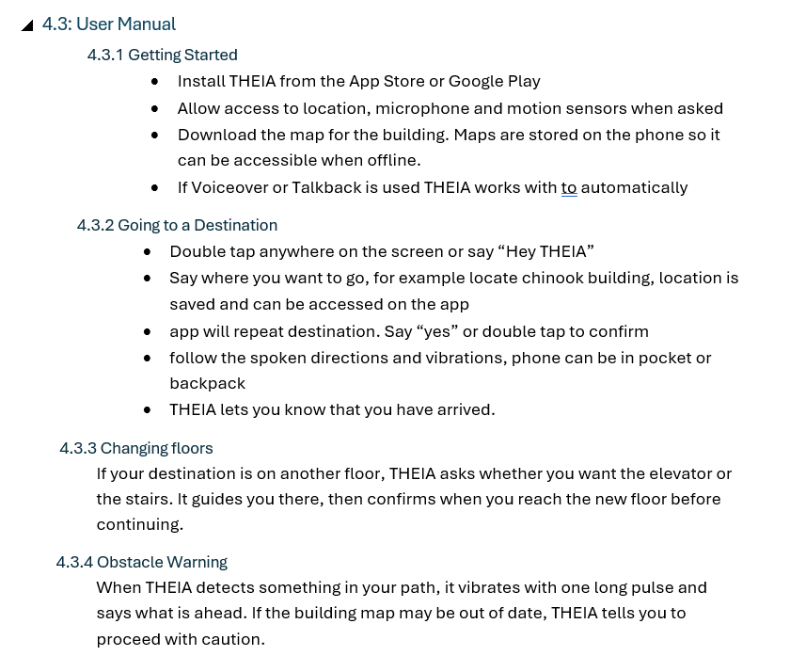
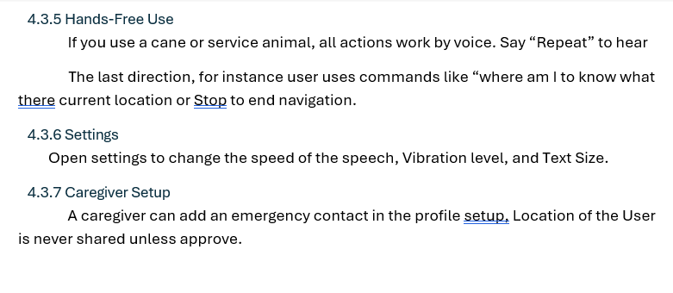
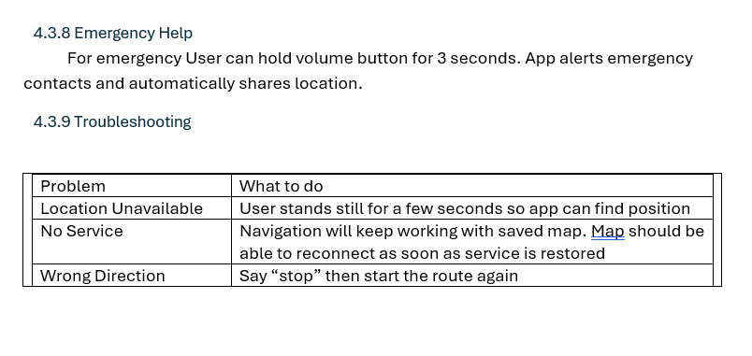
User Manual

